Slide 1
大学英语
Lesson 3 代词
主讲人：周丽莉

Slide 2
CONTENTS
01.
05.
人称代词
疑问代词
02.
06.
物主代词
不定代词
03.
07.
反身代词
相互代词
04.
指示代词

Slide 3
代词概念
代词是用来代替名词以及代替起名词作用的短语、分句或句子的词。
代 词
人称代词
物主代词
反身代词
指示代词
疑问代词
不定代词
相互代词
关系代词
连接代词

Slide 4
人称代词
1

Slide 5
1. 人称代词
表示“我、你、他、她、它、我们、你们、他们”的词。
 | 我 | 你 | 他 | 她 | 它 | 我们 | 你们 | 他们
主格 | I | you | he | she | it | we | you | they
宾格 | me | you | him | her | it | us | you | them

Slide 6
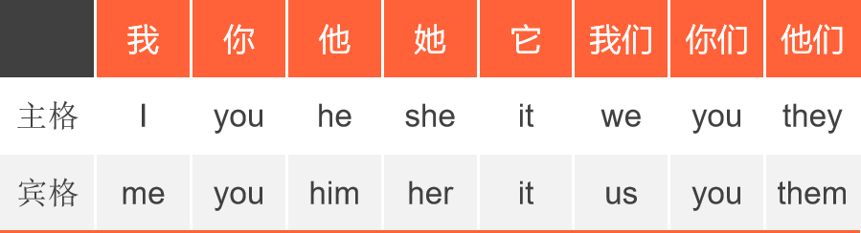

1. 人称代词
人称代词的用法
（1）人称代词的主格可用作主语。
如: I am a student.
Tips:表示国家、城市、大地、月亮等事物的名词可用she来指代，表示一种亲密的感情。
如：China always does what she has promised to do.

Slide 7
1. 人称代词
人称代词的用法
（2）人称代词的宾格可用作宾语。
如: I don’t like him.
He gives me an apple.
The child make you happy.
Lily told us that the flowers were red.

Slide 8
1. 人称代词
it 的用法
用作代词
人称代词it可以用来代替一个名词、短语、句子，以免重复。
(1)特指刚提到过的同一事物 （同一）
This is my new car. I bought it yesterday.
(2) 指动物或不考虑性别的婴儿
Where is the cat? It’s under the bed.
The baby cried when it was hungry.
(3) 在情景中确认某人或事物（不知性别的人）
Who is it? It’s me. (敲门)
---Who’s it over there?
---It’s the milkman.

Slide 9
1. 人称代词
it 的用法
用作代词
(4) 指代前句或后句所述的情况/事情
He smokes in bed and I don’t like it.
It would be great if you could join us.
(5) 指时间、距离、天气或环境等（非人称代词）
What time is it? It’s seven.
It’s about 50 kilometers from here to my home.
It is snowing.
It was very quiet in the garden.

Slide 10
I was disappointed with the film ，I had expected _______ to be much better．
A．that B．this C．one D．it
2. Tom's mother kept telling him that he should work harder, ___ didn't help.
A.he B. that C. she D. but it

Slide 11
1. 人称代词
it 的用法
用作引导词
(1) it用作形式主语: 当_______,_______,_____作主语时，常用it做形式主语。
It’s a pity to refuse.
拒绝是令人遗憾的。
It’s no use saying any more about it.
再谈这事没有用。
It’s not known where she went.
她到哪里去了没人知道。
不定式
动名词
从句

Slide 12
注意it作形式主语时以下常用搭配：
It’s no use/ no good/ no pleasure/ useless/ a waste of…+doing
B. It is said (reported / believed / expected/ accepted…) that… 据（报道，认为…）….
C. It happens (appears, seems…)that…;
It struck me/occurred to me that…突然想到..
D. It is a pity(no wonder, ) that…
E. It doesn’t matter that… …没关系 ;
It makes no difference that… …没影响
F: It’s important(necessary, easy, kind…) ___/____sb to do sth.
for
of

Slide 13
他说什么都没关系。______________________________
他好像总是对的。_________________________________
碰巧我当时没有带钱。_____________________________
据说他已经入党了。_______________________________
It doesn’t matter what he said.
It seems that he is always right.
It happened that I didn’t have money on me.
It is said that he has joined the party.

Slide 14
___ difficult to be in a foreign country, especially if you don’t speak the language.
That is always B. It is always
C. It would be always D. That will always be
2. ___ one day they will have enough animals to set them free.
It is hoped for B. what is hoped that
C. As is hoped that D. It is hoped that

Slide 15
1. 人称代词
it 的用法
用作引导词
(2) it用作形式宾语: 当_______,_______,_____作宾语且其后跟有宾补时，使用形式宾语it，而将真正的宾语移至句末。这类的动词有使役动词，find, make，feel, think, consider, see to it that…(务必)等。
I think it highly unlikely that I‘ll get the job. （宾语从句，it作形式宾语）
我认为我得到这份工作的可能性极小。
I find it easy to get on with her.
（I find to get on with her easy.）
不定式
动名词
从句
宾语补足语指在英语中有些及物动词，接了宾语意义仍不完整，还需要有一个其他的句子成分，来补充说明宾语的意义、状态等，简称宾补。
如：I'm going to paint the desk pink.
我打算把桌子涂成粉色。
"pink" 是句子中的宾语补足语，pink阐述了the desk的状态，让句子意思更加完整。

Slide 16
1. 人称代词
it 的用法
强调句（It is/was +被强调部分+ that/who...）
A. It 后用is或was这种单数形式。
B. 被强调部分是指人时，用 that/who，被强调部分指物时，用that。
C. 被强调部分是指时间或地点时，用that，一般不用when，where之类的。
It is I who/that am right. 是我对。
It was yesterday that he got married.

Slide 17
Tips:
试判断以下两个句子，哪个是it 强调句？哪个是it作形式主语？
It is the boy who I care for.
强调句
It is fun that we spend the holiday here.
it作形式主语
区分方法：
最好的办法是：把 it is/was 后的部分放到 that/who...的后面，如果能组成完整的句子，就是强调句，否则就不是。
把第一句the boy放到后面，变成 I care for the boy. 句子完整，所以是强调句。

Slide 18
1. 人称代词
it 的用法
常考的固定短语
make it go for it take it easy stick it out

Slide 19
物主代词
2

Slide 20
2. 物主代词
表示所有关系的代词叫物主代词。
物主代词分形容词性物主代词和名词性物主代词。
形容词性物主代词 | my | your | his | her | its | our | your | their
名词性物主代词 | mine | yours | his | hers | its | ours | yours | theirs
汉语 | 我的 | 你的 | 他的 | 她的 | 它的 | 我 们的 | 你 们的 | 他（她、它）们的

Slide 21
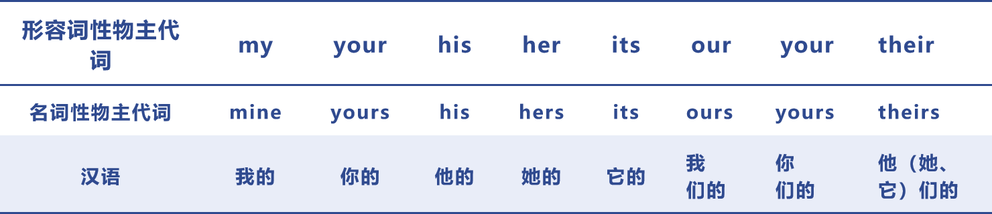
2. 物主代词
物主代词的用法
（1）形容词性物主代词的作用相当于形容词，可在句中作定语。
如: Our teacher is coming to see us.
This is her pencil-box.

Slide 22
2. 物主代词
物主代词的用法
（2）名词性物主代词的作用相当于名词，在句中可用作主语、宾语和表语。”of+名词性物主代词”可以用作定语。
如: Our school is here, and theirs is there．作主语
— Is this English book yours ? （作表语）
— No．Mine is in my bag．(mine= my book)
I've already finished my homework．Have you finished yours? （作宾语）
Marry is an old friend of mine.

Slide 23
反身代词
3

Slide 24
3. 反身代词
反身代词是一种表示反身或强调的代词。
它的基本含义是:通过反身代词指代主语，使施动者把动作在形式上反射到
施动者自己。
因此，反身代词与它所指代的名词或代词形成互指关系，在人称、性质、
数上保持一致。
反身代词是由第一人称、第二人称形容词性物主代词或第三人称人称代词宾
格形式，词尾加self或selves组成。
反身代词可译为"本人"、"本身"，为加强语气，也常译为"亲自"、"自己"

Slide 25
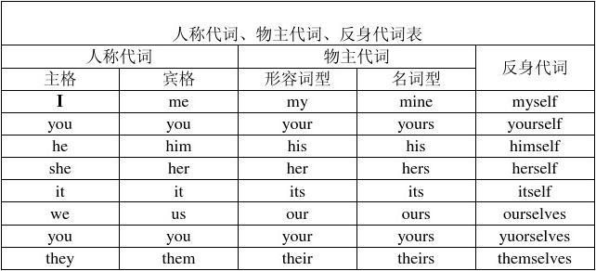
3. 反身代词

Slide 26
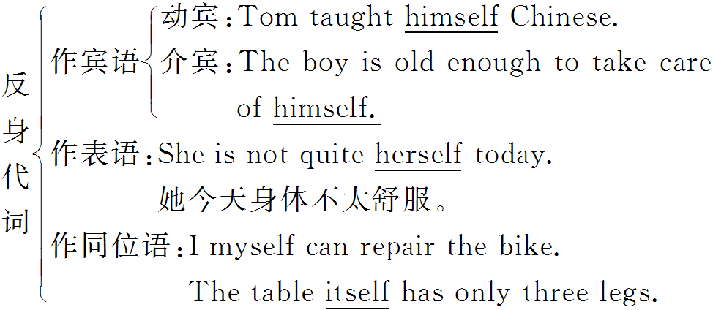
3. 反身代词
反身代词的用法

Slide 27
【说明】 反身代词的惯用语：
by oneself独自
for oneself为自己，亲自
of oneself自动地，自发地
help oneself to随便吃……，自行取用
come to oneself苏醒
make oneself at home不要客气

Slide 28
指示代词
4

Slide 29
4. 指示代词
指示代词包括：this，that，these，those.
可用作主语、宾语、表语和定语。
（1）this和these一般用来指在时间或空间上较近的事物或人，that和those则指 时间和空间上较远的事物或人，例如：
We are busy these days．
In those days the workers had a hard time．
This is a pen and that is a pencil.

Slide 30
4. 指示代词
指示代词包括：this，that，these，those.
可用作主语、宾语、表语和定语。
（2）this和these常指后面要讲到的人或物，有启下的作用；而that和those则指前面提到过的的事物或人，有承上的作用。例如：
What I want to tell you is this:the meeting is put off till Friday.
He had a heavy cold. That was why he didn’t attend the meeting.

Slide 31
4. 指示代词
指示代词包括：this，that，these，those.
可用作主语、宾语、表语和定语。
（3）有时为了避免重复提到的名词，常可用that或those代替，例如：
Television sets made in Beijing are just as good as those made in Shanghai．

Slide 32
4. 指示代词
指示代词包括：this，that，these，those.
可用作主语、宾语、表语和定语。
（4）this 在电话用语中代表自己，that 则代表对方。例如：
Hello! This is Mary．Is that Jack speaking?

Slide 33
B
1.The life in Japan is different from ___ in America.
A. one B. that C. it D. those
2. –Who is that speaking? --_______
A. I am Ann. B. It’s Ann. C. That is Ann.
3. As a matter of fact, Saudi Arabia’s oil reserves are second only to ______.
A. Kuweit B. that of Kuweit
C. Kuweits’s D. those of Kuweit
B
D

Slide 34
疑问代词
5

Slide 35
5. 疑问代词
疑问代词有who，whom，whose，what和which等。
疑问代词用于特殊疑问句中，一般都放在句首，并在句子中作为某一句子成分，表达疑问。
如：Who is going to come here tomorrow? （作主语）
What is that? (作表语)
Whose umbrella is this? (作定语)
Whom are you waiting for? (作宾语)

Slide 36
5. 疑问代词
TIPS:
疑问词和一些形容词、副词、限定词等一起构成的表示疑问的词组也可用来提问。
如：
how often
how many
how long
how much
how far

Slide 37
A
1.--______ is that man? --He is my headmaster.
A. Who B. Whose C. What D. Which
2. Can you tell me _____ she is waiting for?
A. why B. whose C. whom D. which
3. –Who is singing in the classroom?
--____ must be Susan.
A. She B. It C. This D. He
C
B

Slide 38
不定代词
6

Slide 39
6. 不定代词
不定代词表示不特定的人或物和不定数量的代词。
在句中可作主语、表语、宾语和定语。
包括：both, either, neither, one, the other, another, little, few, some, any, each, every, no, none等，从实际应用和理解出发，重点学习以下几个：
(一) both, either, neither
(二) one, another, the other
(三) little, a little, few, a few
(四) some / any, no / none, each / every, many / much

Slide 40
不定代词 | 含义 | 数量关系 | 作定语时名词的数 | 作主语时动词的数
both | 两者都 | =2 | 复数 | 复数
either | 两者中的任何一个 | =2 | 单数 | 单数
neither | 两者都不 | =2 | 单数 | 单数
all | 三者或三者以上都 | ≥3 | 单数或复数 | 单数或复数
none | 三者或三者以上都不 | ≥3 | ○ | 单数或复数
each | 每一个 | ≥2 | 单数 | 单数
every | 每一个 | ≥3 | 单数 | 单数

Slide 41
both, either, neither
both为“两者都”，neither为“两者都不”，either为“两者之一”。这三个单词都用于指两个人或物，在句中可作主语、宾语和定语。
作主语：
1) Both of them enjoyed the rice. 他们两人喜欢吃米饭。
2) Both (of) my children are at school now.
3) Neither (of us) is a doctor. 我们俩都不是医生。
4) Either (of you) will go. 随你们哪个去都可以。
注意：作主语时，both后面的谓语动词用复数。neither, either后面的谓语动词一般用单数形式。
作定语：
1) Both Zhang Hua's father and mother work in a hospital, but neither one is a doctor. 张华的父母亲在一所医院工作，但都不是医生。
2) You may take either apple. 两个苹果任你拿一个。
注意：both后常跟of短语，of后可接复数名词或复数代词。但如果后接复数名词时，of常省略；后接复数代词时，of不能省略。

Slide 42
作宾语：
1) I like both of the toys very much. 我非常喜欢这两件玩具。
2) The boy could find neither of them and went away. 这男孩找不到他们俩就走开了。
3) You may plant either in the street. 你可以种在街道的任一边。
both 还可作同位语，它们句中的位置是在动词be，助动词或情态动词的后面，但在实义动词前面。
1) They are both in good health. 他们两人身体都很好。
2) They will both go there. 他们两人都收到那儿去。
3) They both agreed to take part in the birthday party. 他们两人都答应参加生日晚会。

Slide 43
此外，either 可作副词用于否定句，表示 “也”，相当于肯定句中的 “too”。
This is not mine. That is not, either. 这不是我的，那也不是。
neither 表示“也不”的时候，常用在倒装的结构形式中：
I don't like to play football. Neither does he. 我不喜欢踢足球，他也不喜欢。
She hasn't got a bike. Neither have I. 他没自行车，我也没有。
注意，both 和 and, either 和 or, neither 和 nor 可构成连词。both...and...表示“和……两个都”，连接主语时谓语动词是复数；后俩表示“不是……就是”；“或……或”，“既不……也不”；“……都不” 连接两个并列主语时谓语动词的数一般应与靠近谓语动词的主语保持一致，即就近原则，如：
1) Both Zhang and Wang are good students. 张、王都是好学生。
2) Either you or he is right. 不是你就是他对的。
3) Neither he nor I am a scientist. 他和我都不是科学家。

Slide 44
one, another, the other
1. one 常用来作代词，表泛指，替代前文所出现的可数名词，表示人或物，以避免重复, 其复数为ones。例如：
I haven't got a ball pen. I'll have to buy one. (= a ball pen) 我没圆珠笔，我得去买一支。
2. the other, another 都可解释为 “另一个”。other 加上定冠词用于两者中的另一个，another 指三者以上中的另一个。例如：
He has two brothers. One is a doctor, the other is a teacher.
We've received two parcels, one from my uncle, the other from my aunt.
I don't like this one, show me another, please.
I've just bought three things. One is a walkman, another is a pocket calculator, the third is a video game.

Slide 45
3. another 还有 “再……” 的意思，例如：
Have another cup of coffee, please. 再喝一杯咖啡吧！
She could have to stay here for another week. 他将在这里再待一个星期。
4. other 有 “另外，其他” 的含义。例如：
Where are the other students? 其他学生在哪里？
The boy is much cleverer than the other two. 这孩子比另两个更聪明。
5. others 和 the others 表示复数的泛指和特指。例如：
In the park some are playing games. Others are walking near the river.
I have five colour pencils. One is red, another is blue and the others are green.
6. the rest 也可作 “其余的” 解释。它用作主语时注意谓语动词的单复数。例如：
The rest of his life was spent in America. 他的余生是在美国度过的。
He has eight books. Two are in English. The rest are in Chinese. 他有几本书，两本是英文，其余的是中文。

Slide 46
little, a little, few, a few
1. little 与 a little 两者都用来修饰不可数名词，little 作 “很少”，“几乎没有” 解，有否定的意思，a little 作 “少许”、“有一点” 解，有肯定的意思，例如：
In this way they can make the trip with just a little money.
用这种方法他们只花很少的钱就能旅行。
There is little left, is there? 没剩多少了，是吗？
2. few, a few 用来修饰可数名词，前者表示否定，后者表示肯定。
A few of us speak English well. 我们中有几个人英语讲得很好。
There were few eggs is the fridge, so he went to the supermarket and bought some. 冰箱里几乎没鸡蛋了，所以他去超市买了一些。
3. few 作主语时，谓语动词仍用复数，例如：
Few men know this, do they?
4. 常用词组有 quite a few (好几个)，only a few (只有一个)，a very few (极少数)。例如：
He studied Chinese for quite a few years. 他学汉语已有好几年了。

Slide 47
some, any, no, none, each, every, many, much
（1）some 和 any:
some (一些，某个) 句中可作主语、宾语、定语等，常用于肯定句。作定语时，它可修饰可数名词和不可数名词，可数名词是单数时，some 表示 “某个” 的意思。例如：
There are some newspapers on the table.（一些）
I am going to buy some orange juice.（一些）
Have you any questions? Yes, I have some. （一些）
I have read that in some magazine.（某个）
当说话者表示提议、请求或期望得到肯定回答时，在疑问句中也可用 some。例如：
Would you like some tea?
Could you lend me some money?
any “一些” 用法相同于 some, 但多用于疑问句、否定句或条件从句。例如：
Is there any ink in your pen?
Put up your hands if you have any questions.

Slide 48
注意：
1. any 用于肯定句中有 “任何一个” 解。常用于比较级句子中。
Tom runs faster than any other boy in his class.
Tom runs faster than any of the other boys in his class.
2. some, any, every, no 可以与 body, thing, one 构成合成代词，这些代词都作单数看待，表示人或物：
Something is wrong with my bike.
Someone is asking to see you.
Nobody is absent.
If you want anything, call me.

Slide 49
（2）no 和 none:
none (没有一个，全不，都不) 是名词性的不定代词，用于三个或三个以上的人或物，可作主语和宾语，常和 of 短语连用，不作定语。none 作主语代替不可数名词时，谓语用单数形式。代替可数名词时，谓语用单、复数均可。例如：
None of us is / are from Beijing.
None of the money is mine.
none 与 all 相对，有 “全不”vs. “全部” 的含义，因此 all 是全肯定，none 是 all 的全部否定，但都指三者以上的人或物。
We all made mistakes.
None of us was correct.
no 是形容词性的不定代词，只能用作定语，可修饰可数和不可数名词。no 等于 not a 或 not any 加上名词。例如：
I have no money.(作定语)
I have not any money.
no one 相当于 nobody，意为没有人，谓语用单数，不与of连用。
none常用结构：
none of sb./sth.
all常用结构：
all（ + the/this/that/my/her/his等) + 名词

Slide 50
（3）each 和 every ：
each (每个，各自的) 强调个体，可作主语、宾语、定语、同位语，用于两个或以上。
every (每个都，一切的) 相当于all，强调整体、共同性，只能作定语，用于三个或以上。
Each boy has a dictionary. 每个孩子都有一本词典。
Every boy has a dictionary. 所有的孩子都有一本词典。
注意： every 构成的常用词组
every other day 每隔一天 / every other five days 每隔五天
every other line 每隔一行 / every five days 每五天
（4）many 和 much ：
many 修饰可数名词的复数，谓语用复数，much 修饰不可数名词，谓语用单数，它们可用在肯定句、否定句和疑问句中，还可在肯定句中作主语或修饰主语。例如：
So much for today.
There are many buses and cars in the street.
many 可被 a lot of, a large number of, a great many 所代替。
much 可被 a lot of, plenty of, a good deal of, a great (large) quantity of 所代替。
但 a lot of / lots of 只能用于肯定句。

Slide 51
拓展讲解：英语中的部分否定与完全否定的情况
英语中的部分否定（即不完全否定）有如下一些表示方法：
一、 all 的否定式：not all…（或：all…not）表示"并非都……"、"不是所有都……"，all的否定式都是表部分否定。如：
Not all men can be masters. (= All men cannot be masters.)
并非人人都能当头头。
Not all bamboo grows tall.
并非所有的竹子都会长得很高。

Slide 52
拓展讲解：英语中的部分否定与完全否定的情况
英语中的部分否定（即不完全否定）有如下一些表示方法：
二、 both 的否定式：not…both (或：both… not) "并非两个……都……" 如：
I don't want both the books.
我不是两本书都要。
Both (the) windows are not open.
两扇窗子并不都开着。

Slide 53
拓展讲解：英语中的部分否定与完全否定的情况
英语中的部分否定（即不完全否定）有如下一些表示方法：
三、 every…的否定式："不是每……都……" 例如：
Not every book is educative. (或：Every book is not educative.)
不是每本书都有教育意义的。
Not everyone likes this book.
并非人人都喜欢这本书。

Slide 54
拓展讲解：英语中的部分否定与完全否定的情况
英语中的部分否定（即不完全否定）有如下一些表示方法：
四、 always的否定式："并非总是（并非一直）……" 例如：
He is not always so sad.
他并不是一直都这样悲伤。
五、 entirely, altogether, completely 和quite 的否定式，"不完全……"，"并非完全……" 例如：
The businessman is never to be entirely trusted. 不可以完全信任商人。
He felt not altogether satisfied. 他并不完全满意。
I don't agree completely. 我并不完全同意。
What he did was not quite proper. 他做的不十分妥当。

Slide 55
拓展讲解：英语中的部分否定与完全否定的情况
英语中的部分否定（即不完全否定）有如下一些表示方法：
六、 all the time 的否定式："并非一直……"、"未必老是……" 例如：
A foolish man doesn't make a mistake all the time.
笨人未必老是犯错误。
七、 not…and…的否定式，被否定的往往是and后面的那一部分。 例如：
He did not speak clearly and correctly. 他讲得清楚但不正确?
This film is not interesting and instructive. 这部电影有趣但无教育意义。
She cannot sing and dance. 她会唱歌但不会跳舞。
【如果将and 换成or，not 对其后面的两部分就全盘否定 了。 He did not speak clearly or correctly. 他讲的既不清楚也不正确。 】

Slide 56
拓展讲解：英语中的部分否定与完全否定的情况
英语中的部分否定（即不完全否定）有如下一些表示方法：
如要对上述的all, both, every, always, 以及entirely, altogether, completely, quite 和 all the time 等词作完全否定，那就分别要用与之相对应的全否定词，如no, none, neither, no one, never, not (never)… at all 等。例如：
All of them can do it.--- None of them can do it.
Both are good.---Neither is good.
Everybody likes it. ---Nobody likes it.
He is always late. --- He is never late.
We don't trust them entirely. --- We never trust them at all.
He was here all the time. --- He was never here.
以及：
every----no
everyone----no one/ noboday
everything----nothing
....

Slide 57
1. ______ of them knew about the plan because it was kept a secret.
A. Each B. Any C. No one D. None
2.We couldn’t eat in a restaurant because ______ of us had ______ money on us.
A. all ; no B. any ; no C. none ; any D. no one ; any
3.There is a tree on _______ side of the street.
A. every B. all C. either D. both
4.There is a desk on _______ side of the room.
A. both B. either C. all D. every
5. — Which side can I sit on the boat?
— If you sit still, you can sit on _______.
A. every side B. all sides C. both sides D. either side
6.It is said that _______ of his parents have gone to Beijing.
A. all B. every C. both D. either
2题：注意部分否定、全否定的问题

Slide 58
7.Some students are absent-minded, _______ of them heard what the teacher said.
A. all B. none C. every D. not all
8. — Is _______ here?
— No, Bob and Tim have asked for leave.
A. anybody B. somebody C. everybody D. nobody
9.They were all very tired, but ______ of them would stop to take a rest.
A. any B. some C. none D. neither
10. — Can you come on Monday or Tuesday?
— I’m afraid _______ day is possible.
A. either B. neither C. some D. any
11. If you want to change for a double room you’ll have to pay _____ ﹩5.
A. another B. other C. more D. each

Slide 59
No one与none好分辨。/具体人，物把none填。 不知何人与何物，/No one, nothing是一路。 No one人nothing物，/保你不会出错误 everyone 指人，是代词，单独使用，不可以和of 连用。
如想和of连用，则应使用 every one

Slide 60
在肯定句中anything与everything的区别 :
A) Anything (任何事情)
定义 : Any thing whatever; something, no matter what. 无论任何事情; 事, 无论什么. 例: Anything will be fine for me. (肯定句) 对我来说, 任何事都可以的.
B) Everything (所有的事情) 定义 : All things or all of a group of things; all. 所有的事情或一堆事物裡的全部;所有. 例: Everything is on the right track.(肯定句) 一切事情都上轨道. Anything 是 Everything 里的任何一事.

Slide 61
** 此外** A) Anything 1)可当否定 / 条件句用 : He will be in big trouble if anything goes wrong. 如果出了岔子, 他將会有大麻烦. 2)可当疑问句用 : Do you have anything for a toothache? (当代名词用) 你有什么東西可止牙痛的吗？ 3)可当副词用 : 定义 : In any degree; to any extent; in any way; at all. 在任何等级; 在任何程度上;以任何方式; 在所有. 例: Does it taste anything like chocolate? 嚐起來像任何巧克力口味吗？

Slide 62
B) Everything 1)可当名词用 : 例: This news means everything to us. 这个消息对我们意味着一切. 例: Money is his everything. 钱是他的一切.

Slide 63
相互代词
7

Slide 64
7. 相互代词
表示相互关系的代词叫做相互代词。
相互代词有each other 和one another两种形式。
在当代英语中，each other和one another没有什么区别。
相互代词可在句中作宾语，定语。作定语用时，相互代词用所有格形式。
each other—— each other’s
one another—— one another’s

Slide 65
7. 相互代词
We should learn from each other / one another.作宾语
Do you often write to each other / one another? 作宾语
We often borrow each other's / one another's books．（作定语）
The students corrected each other's / one another's mistakes in their homework．（作定语）

Slide 66
They visited ____ home.
A. each other B. each other’s C. each others’
2. We should help ______.
A. each other B. each other’s C. each others’
B
A

Slide 67
THANKS

